Slide 1

Diabetes
VEMULAPALLI Sai Pranav
Mark Anthony De Castro

Slide 2
Exploring the Dataset…
10 Attributes:
AGE
SEX
BMI
BP
S1-S6

Slide 3
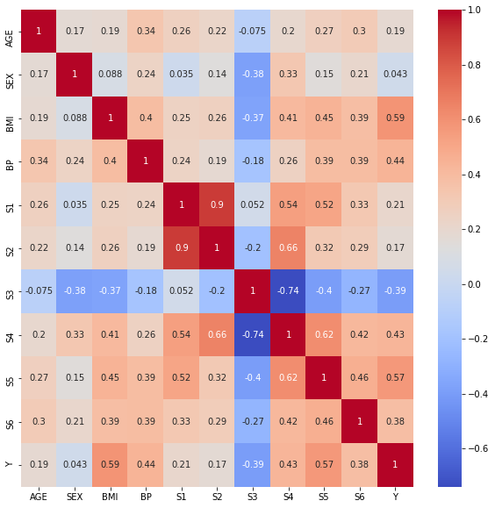
What’s the best attribute?
Best Correlation with Y
BMI=.59
S5=.57

Slide 4
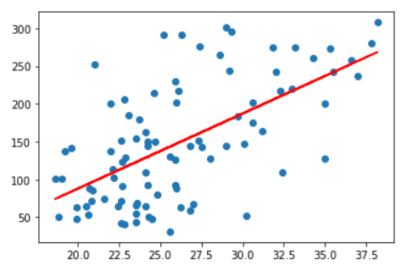
BMI to Y

Slide 5
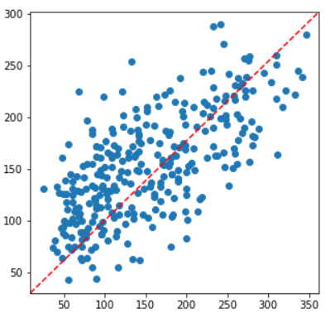
BMI and S5 to Y

Slide 6
Most optimal training size?
Training Size | Training MSE | Validation MSE
20 | 1138.9131289086124 | 6022.590329342689
50 | 1445.370038278792 | 4549.073785729933
100 | 2427.8447762616242 | 3347.626438732811
200 | 2882.574504032785 | 3139.193046631809

Slide 7

3

Slide 8
LET’S PLAY!

Slide 9
Thank you for your attention

